Slide 1
Supervised Learning: Overview 3
Rayid Ghani
Slides liberally borrowed and customized from lots of excellent online sources

Slide 2
Methods
Regression
Nearest neighbor
Decision Trees
Support Vector Machines
Bayes Classifier
Ensembles
Bagging
Boosting
Random Forests
Neural Networks
We’ll cover these today

Slide 3
Why Ensembles?

Slide 4
How can we create ensembles?
Different learning algorithms
Algorithms with different choice for parameters
Data set with different features (e.g. random subspace)
Data set = different subsets (e.g. bagging, boosting)

Slide 5
Ensemble Methods
Bagging (Bootstrap Aggregation)
Boosting
Random Forests
Stacking

Slide 6
Bagging
Create ensembles by repeatedly randomly resampling the training data (Brieman, 1996).
Given a training set of size n, create m samples of size n by drawing n examples from the original data, with replacement.
Each bootstrap sample will on average contain 63.2% of the unique training examples, the rest are replicates.
Combine the m resulting models using simple majority vote.

Slide 7
Bagging
For i = 1 .. M
Draw samples with replacement
Learn classifier C_{i}
Final classifier is a vote of C₁ .. C_{M}
Why does it work?
Increases classifier stability/reduces variance
Works better with unstable classifiers (Decision Trees)
figure from Friedman et al. 2000

Slide 8
Why does it work?
Increases classifier stability/reduces variance
Works better with unstable classifiers (Decision Trees)
What are some problems with it?

Slide 9
Boosting
Examples are given weights.
At each iteration, a new hypothesis/model is learned and the examples are reweighted to focus the model on examples that the most recently learned model got wrong.

Slide 10
Boosting
General Loop:
Set all examples to have equal uniform weights.
For t from 1 to T do:
Learn a classifier, C_{t}, from the weighted examples
Increase the weights of examples C_{t} classifies incorrectly
Base (weak) learner must focus on correctly classifying the most highly weighted examples while strongly avoiding over-fitting.
During testing, each of the T hypotheses get a weighted vote proportional to their accuracy on the training data.

Slide 11
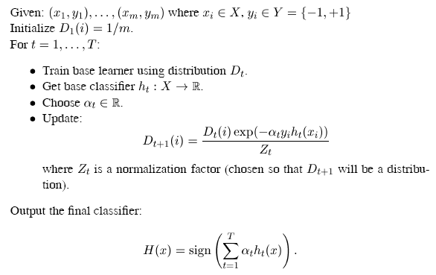

typically
where
the weights of incorrectly classified examples are increased so that the base learner is forced to focus on the hard examples in the training set
From [R. Schapire, NE&C03]

Slide 12
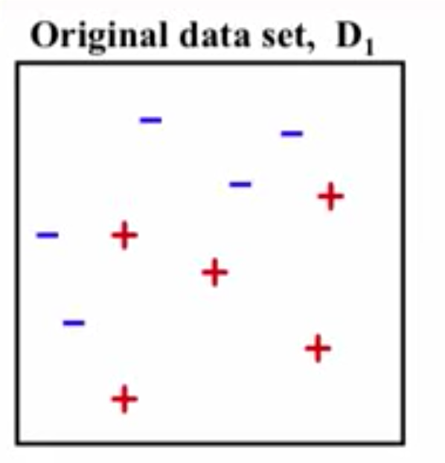
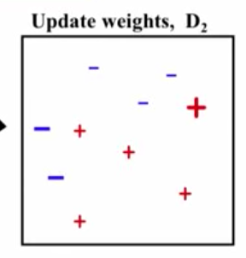
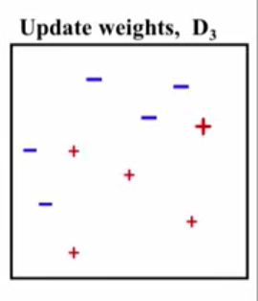
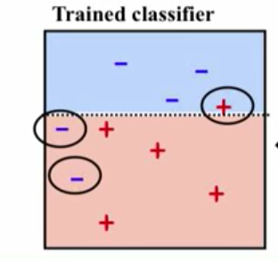
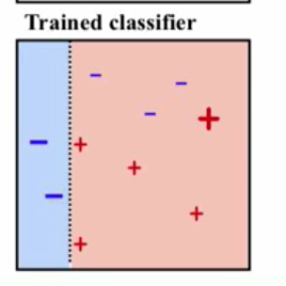
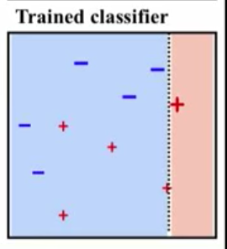

Slide 13
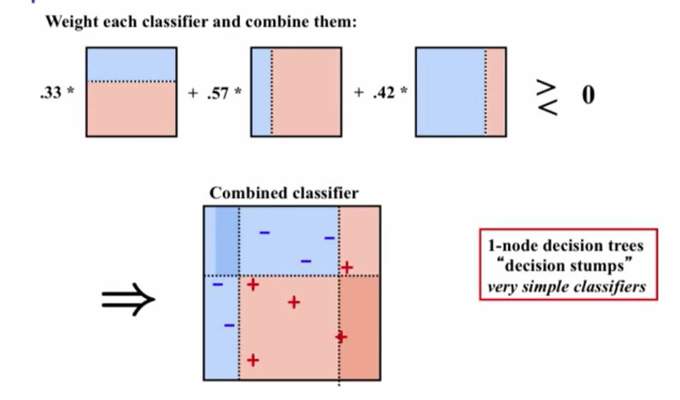

Slide 14
Boosting
Improves classification accuracy
Can be used with many different types of classifiers
figure from Friedman et al. 2000

Slide 15
Random Forest
Each tree is grown on a bootstrap sample of the training set of N cases.
A number m is specified much smaller than the total number of variables M (e.g. m = sqrt(M)).
At each node, m variables are selected at random out of the M.
The split used is the best split on these m variables.
Final classification is done by majority vote across trees.
15

Slide 16
Random Forests
Motivation: reduce error correlation between classifiers
Main idea: build a larger number of un-pruned decision trees
Key: using a random selection of features to split on at each node

Slide 17
Advantages of random forest
Error rates compare favorably to Adaboost
More robust with respect to noise.
More efficient on large data
Provides an estimation of the importance of features in determining classification
More info at: http://stat-www.berkeley.edu/users/breiman/RandomForests/cc_home.htm

Slide 18
Questions to think about?
Could you inject more randomness in random forests?
How?
What would be the impact?

Slide 19
Factors to consider
Complexity
Overfitting
Robustness
Interpretability
Training Time
Test Time

Slide 20
What to remember about classifiers
Better to have smart features and simple classifiers than simple features and smart classifiers
Need more training data with increasingly powerful classifiers (bias-variance tradeoff)
Slide credit: D. Hoiem

